Slide 1
Seeed UV Sensor (Arduino UNO)

Slide 2
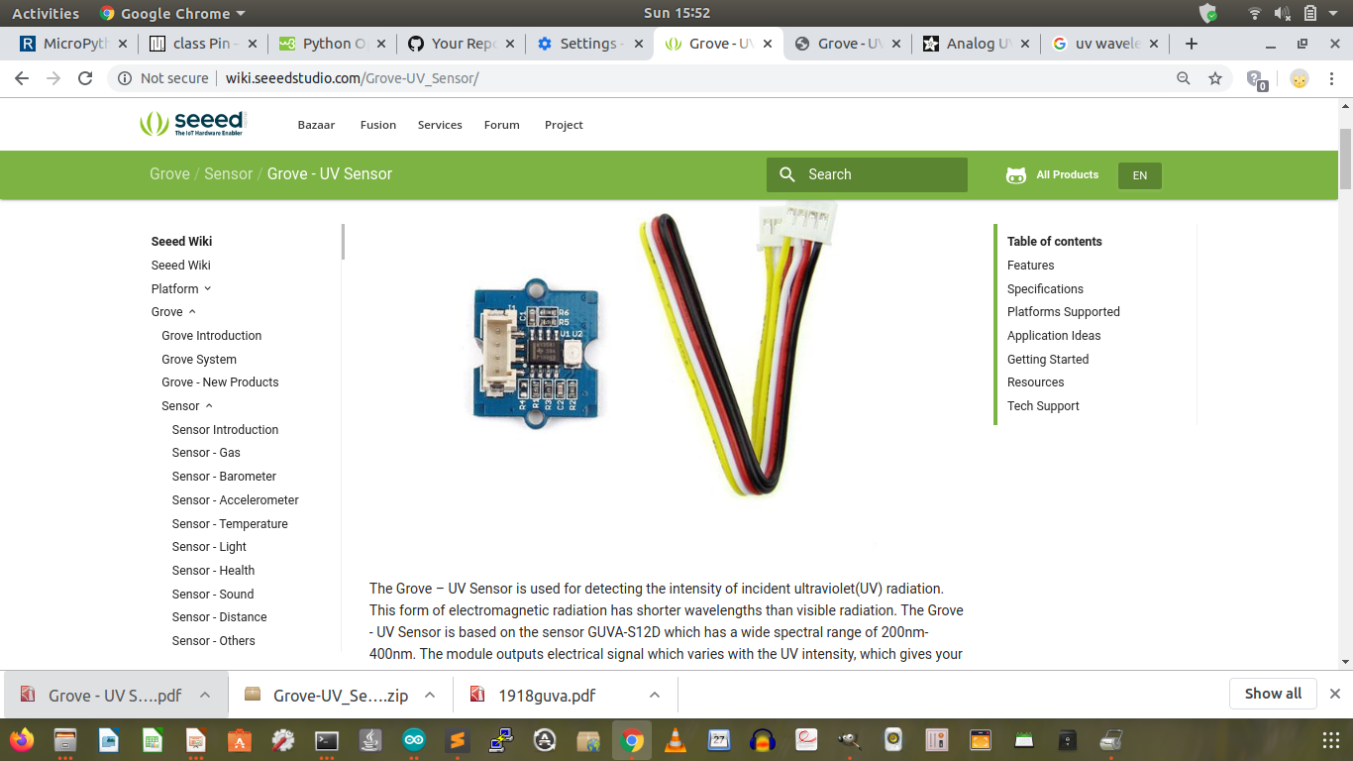
http://wiki.seeedstudio.com/Grove-UV_Sensor/

Slide 3
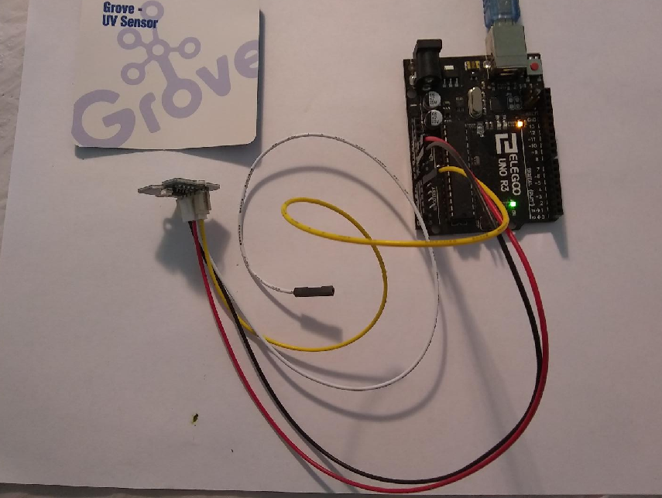
Hardware Connection
Yellow A0 (Analog IN)
White NC
Red 5.0V
Black GND

Slide 4
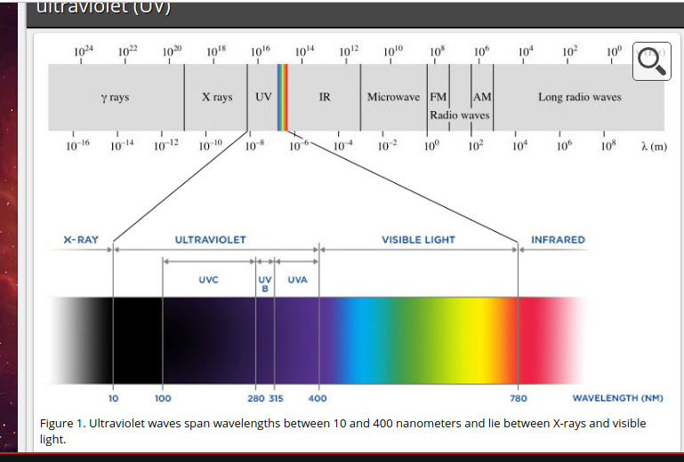
240 – 400 nm (UVB + UVA covered)

Slide 5
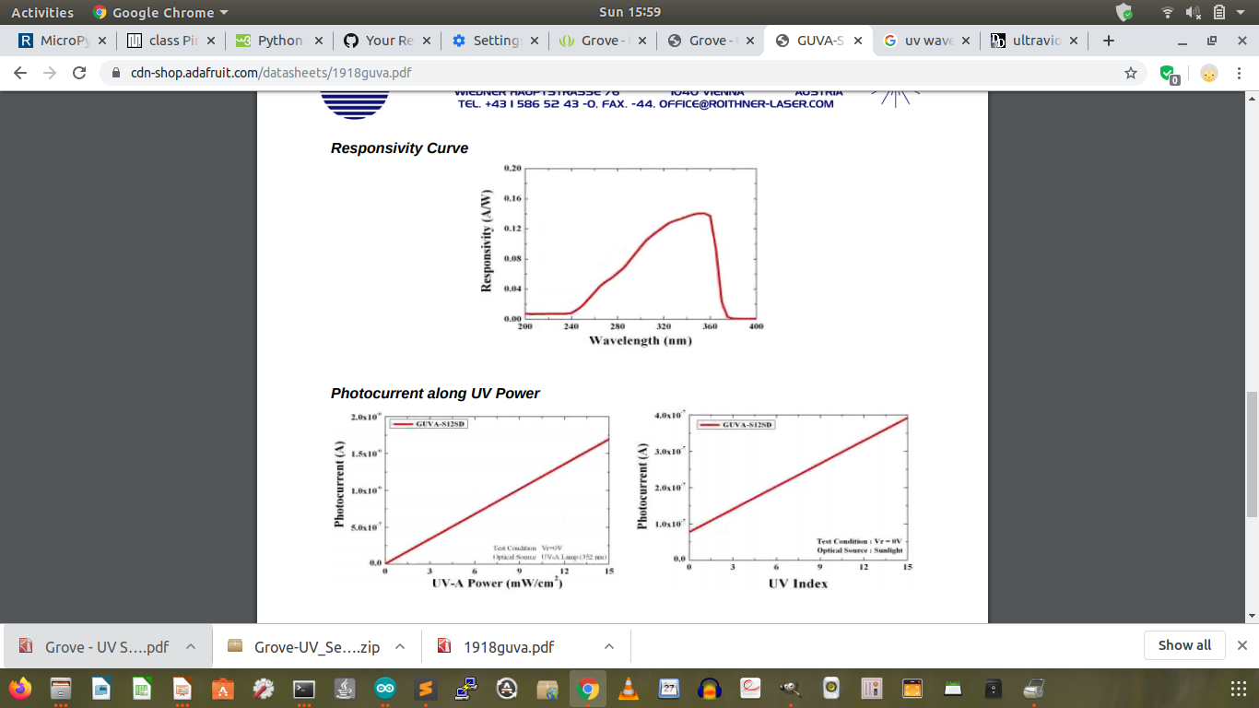
UV Index and Photocurrent has a linear relationship

Slide 6
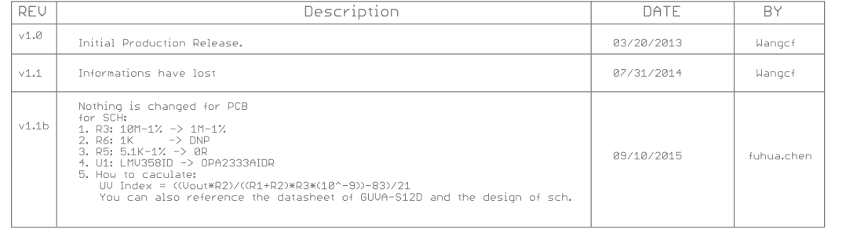
Detailed formula for UV index calculation

Slide 7
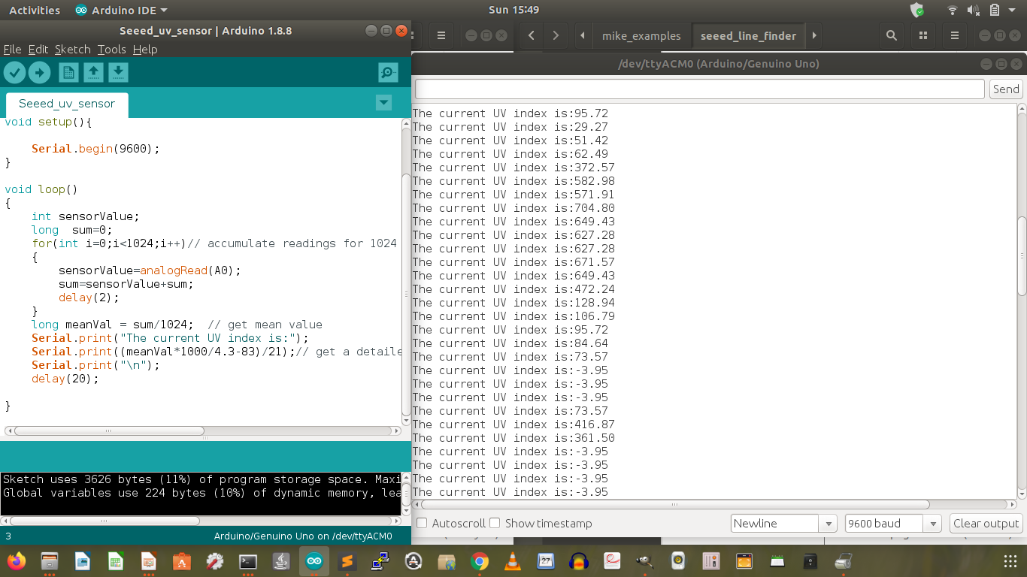
High UV Index (Outdoor under the direct sun light), Low UV Index (Indoor)

